Slide 1
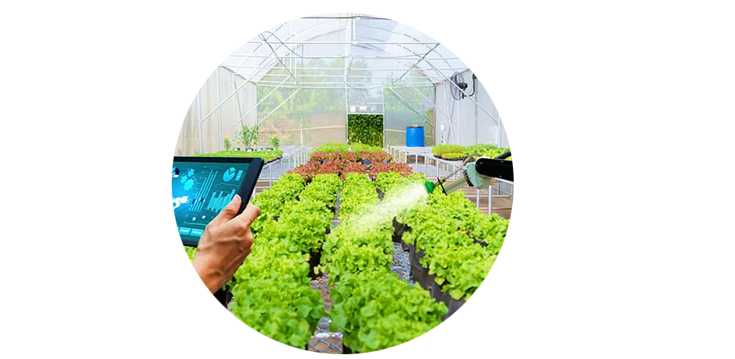
TITLE: A DISTRIBUTED SYSTEM FOR SUPPORTING SMART IRRIGATION USING INTERNET OF THINGS TECHNOLOGY
Authors: Ahmed Abdelmoamen Ahmed, Suhib Al Omari,
Ali Fares, Mohamed Chouikha, Ripendra Awal
PRESENTATION BY: ABRAR AL SAYEM

Slide 2
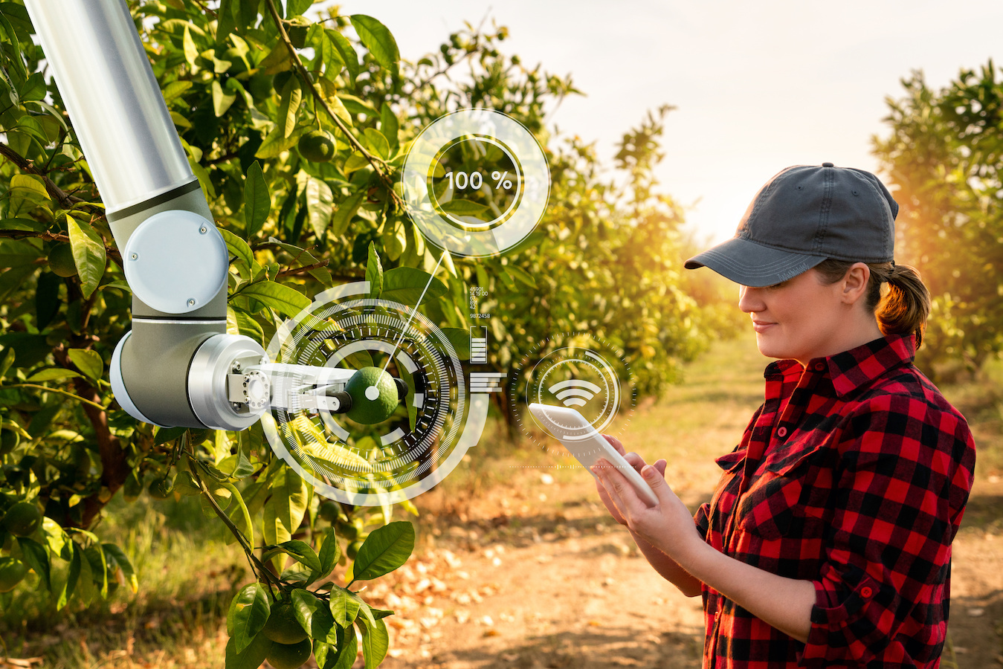
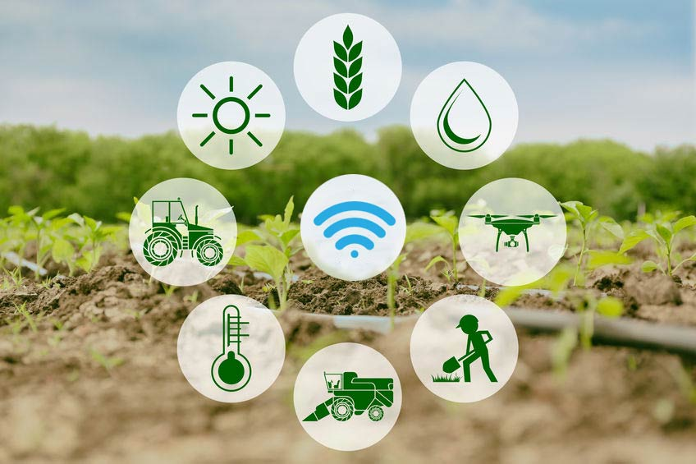
1. OVERVIEW OF PRECISION AGRICULTURE 2. EXISTING IOT APPLICATIONS 3. LIMITATIONS IN CURRENT SYSTEMS
Background and Related Work

Slide 3
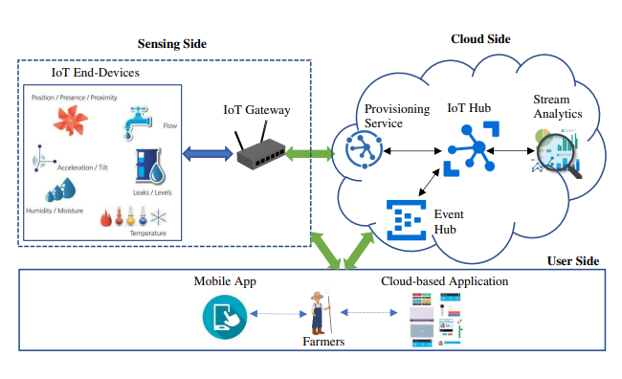
1. SENSING TOOLS AND MECHANISMS 2. CLOUD INFRASTRUCTURE & DATA TRANSMISSION 3. USER INTERACTION CAPABILITIES
System Design

Slide 4
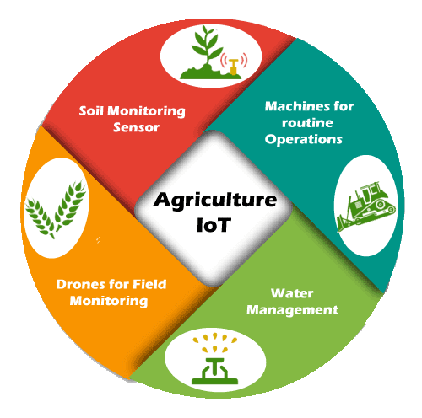
SENSING SIDE
Utilizes a Raspberry Pi 3 device to monitor real-time data on soil moisture, air temperature, relative humidity, and other weather-related parameters. This data is then logged and sent to the cloud side.

Slide 5
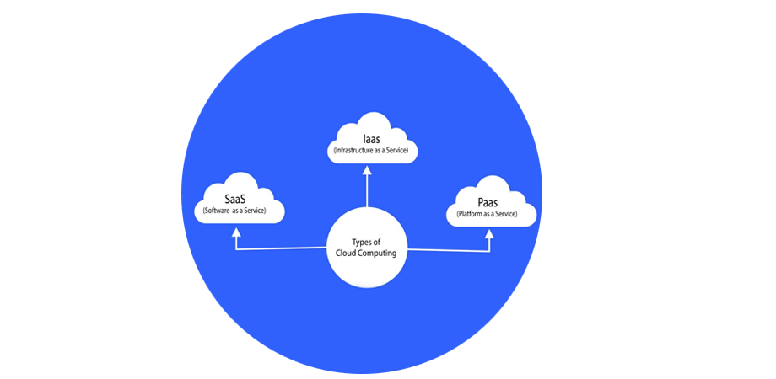
CLOUD SIDE
Employs Microsoft Azure IoT Hub for data reception and analysis. The irrigation scheduling model here determines the water pump's operation based on predefined thresholds.

Slide 6
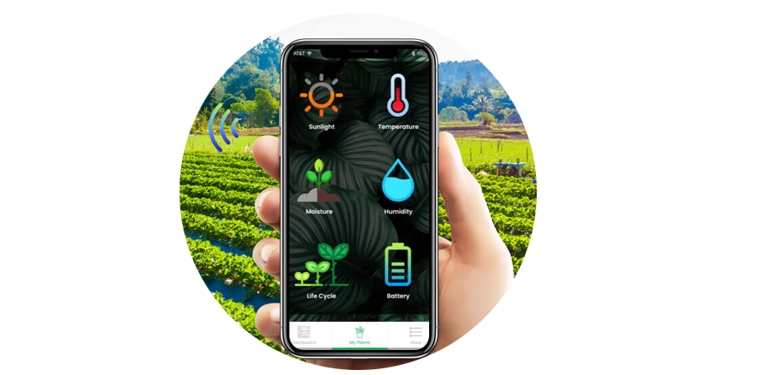
USER SIDE
Provides an Android mobile app allowing users to control the water pump operations, including voice recognition capabilities for enhanced interaction.

Slide 7
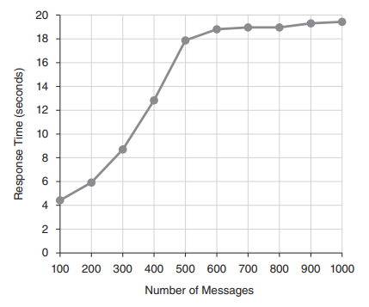
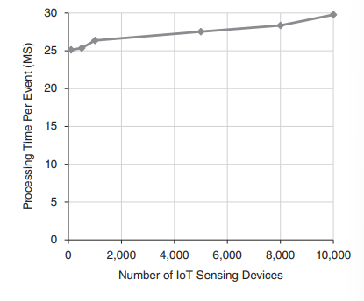
NUMBER MESSAGES ON THE RESPONSE TIME
FIGURE: The effect of changing the number messages on the response time
FIGURE: The effect of changing the number Internet of Things end-devices on the ongoing per-event processing time

Slide 8

CONCLUSIONS AND FUTURE WORK
COMPREHENSIVE
SOLUTION
FLEXIBILITY
SCALABILITY
FUTURE INTEGRATION
LAUNCH
The system developed offers a comprehensive solution for farmers
Users have the flexibility to set various irrigation parameters
Performance and scalability assessments indicate that the system maintains high responsiveness and scalability
plan to integrate ModeSens and ShareSens systems , DL, ML techniques for more accurate predictions
Deploy strategic networks with compelling
e-business needs

Slide 9

SUMMARY
This study introduces an innovative IoT-based system for smart irrigation, enhancing agricultural water efficiency and adaptability. It integrates real-time soil monitoring with automated, user-customizable irrigation mechanisms, demonstrating scalability and responsiveness in performance evaluations. Future enhancements include broader farming applications, predictive analytics, and energy-efficient data sharing.

Slide 10

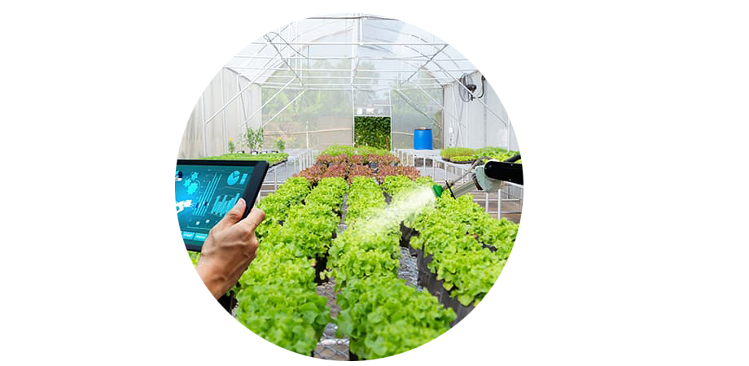
THANK YOU
ABRAR AL SAYEM
18201194| CSE449

